Slide 1
FINAL PROJECT
Intro to Programming
By Fabio Espinoza

Slide 2
What is Django?
A python based free and open source web framework that follows a model-template-views architectural pattern. (MTV)
Models- these are the objects that will be stored in your database. Upon creation they will generate SQL that makes tables for you. These tables have a key (unique id) and specific attributes.
Example) - a User model has a username, first name, last name, email, and password
Templates - this is a directory with a subdirectory of the name of your application. Templates work along with views and are html files used to display content for your website.
Views - used to pass content into templates and link templates to routes in your website. This is done by functions and also classes can be used also.

Slide 3
DJANGO USEFUL COMMANDS
Django-admin startproject - this will initialize a django project and make a directory with python files that a standard django project uses
Python manage.py runserver - Inside every django project is a command line tool file named manage.py and it is used to run the server your project is located on
Python manage.py startapp - Every django project has django apps that can be created with this command.
Python manage.py migrate - this command makes the databases necessary for your django project and installed apps and saves any new migrations that were made
Python manage.py makemigrations yourappname - This will make a migration which is the changes you made to your models and store them based on which app you used

Slide 4
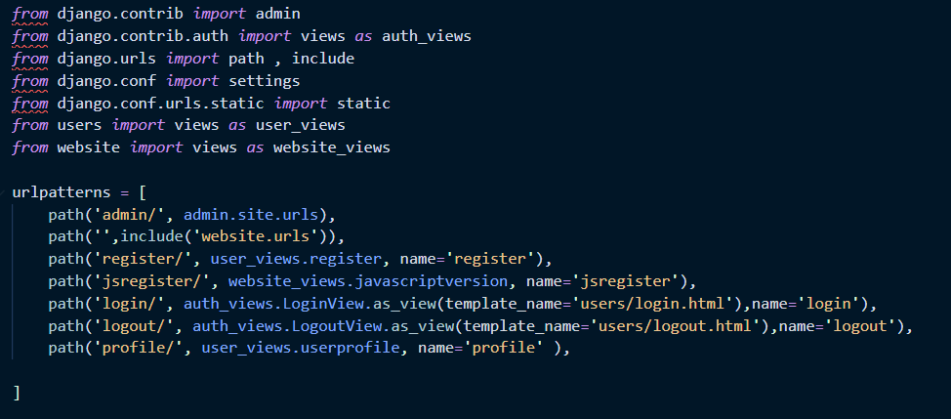
URLS.PY
This is the urls.py file in my django project. This controls the directing of url routes in my website and manages what content is displayed on these routes. This is done by the path() function in the urls module.
The urls module also lets you include other paths and urls.py files from other apps within your project by the include() function
The parameters of path() are a string, a view, and an alias name. We will talk about views later.

Slide 5
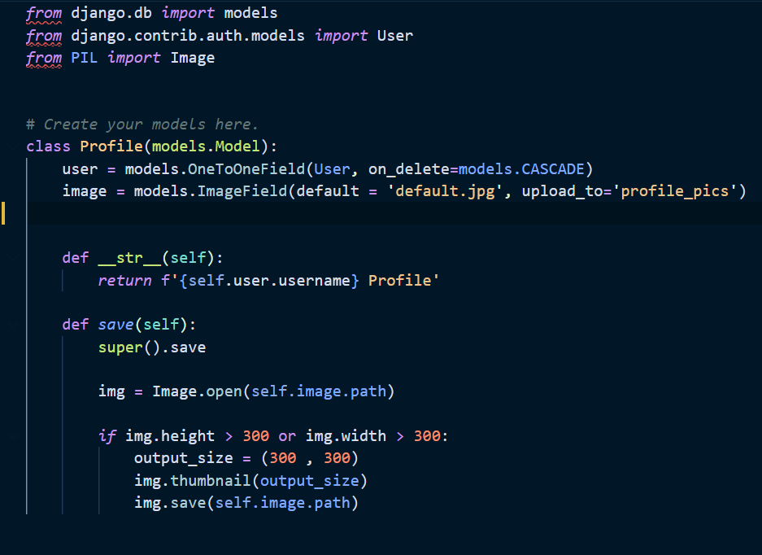
My Models
-Every model is a class that inherits from the models module
-Our Profile model will have a ‘user’ variable that connects to the User model. This is done by the OneToOneField method and acts like a primary key that connects User and Profile model together. The User model is a predefined model that django provides.
- __str__ method is for when we call this model from the python shell and we can identify it more easier
- save method first saves all the properties above into the database and then defines a variable named img. Using the Image class we imported, it instantiates img as an Image object and with the path of the image property we defined in the beginning of the class. Then it sets a conditional to check if an image is too big and resizes it if
needed.
USERS

Slide 6
Forms
Creating the models is the first step but for a user to dynamically make their account and have it be saved in the database a form is required. At the moment we can manually input the fields in the shell and view users from the shell.
To make forms we make a seperate file called forms.py and do some necessary imports.

Slide 7
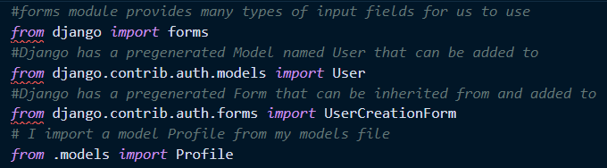
Forms Imports
We import forms module form django that gives us the ability to add many types of fields to our forms such as email, password, username, etc.
We also import a pre generated model named User which Django conveniently offers.
We also import a pre generated form that Django offers named UserCreationForm.
Lastly we import our Profile model we created previously from our models.py file.

Slide 8
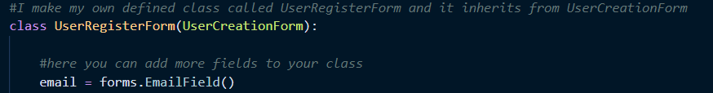
Forms UserRegisterForm
We define a class named UserRegisterForm which inherits from UserCreationForm. This means URF has all the properties of UCF such as username and password. However since we want to add an email field we make a seperate class from UCF thus why we made URF class.
I then make an email variable and use the forms module’s EmailField() method to specify what type of field I want email to be.

Slide 9
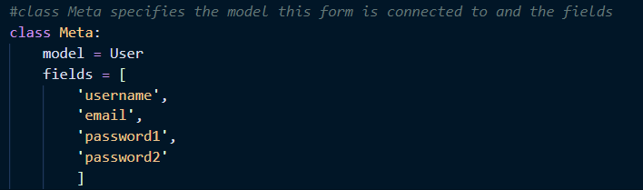
Forms Class Meta
Class Meta is something most forms use to determine what model these fields belong to and what model these data fields should be saved to. Then the fields list specifies which exact fields you want to be displayed in the form and in what order.

Slide 10
FORM AND VIEWS
Okay so our forms are made but how do we display it to our website????
If you remember Views is what links to our templates. Templates is the html files that are displayed to our website. Urls.py uses our views to feed our routes content.
This means the next step to put our form on our website is to make a corresponding view and template and then put the view into our urls.py.

Slide 11
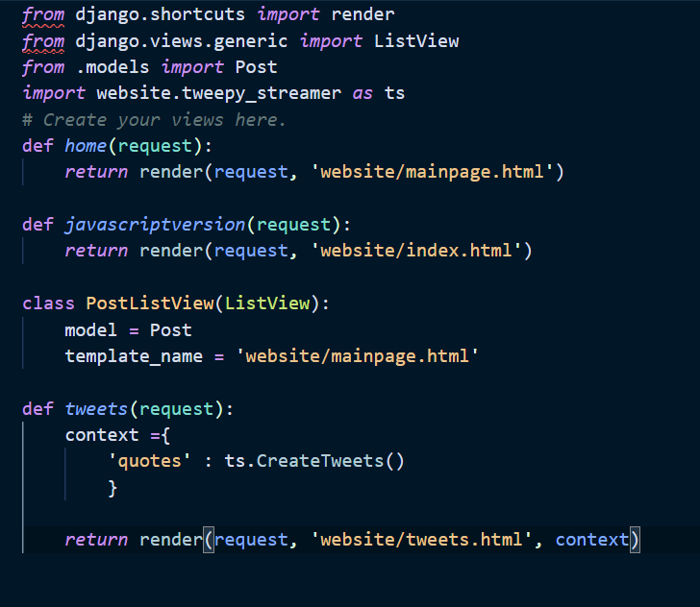
My Views
Usually Views are implemented by functions with a parameter of an httpresponse aliased as request. Then this httpresponse is returned along with a template.
You can also pass in data to a template by making a dictionary and returning it within the return statement. It’s good convention to name the variable context like in the the tweets() view method.
There are also Views that are provided to us by Django that can be implemented by making a class that inherits from the desired module. PostListView(ListView) is an example of this.

Slide 12
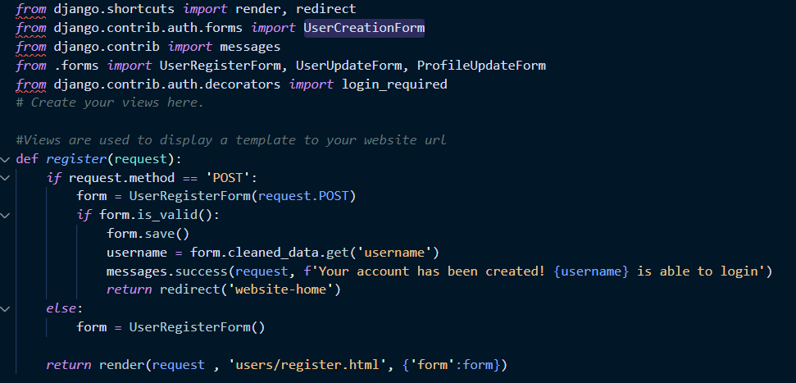
My Views Register
The register view has some logic that checks if the httprequest is a post request and makes a userform and with the built-in functions from the UserCreationForm module that the UserRegisterForm inherits from. We can then validate the forms by the is_valid() given to us by the UserCreationForm module. If the for is validated we save it to the database by the save function. This inputs all the fields (username, password, email) into the database specifically our User model that django pre defined for us. The username is given the value of the username field from our form and can be used for our flash alert message.
However the above will only run if there is a post method request usually done when someone clicks the submit button in a form. Originally this view will just show my register.html template and give it a value of form which is my UserRegisterForm().

Slide 13
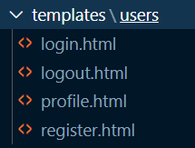
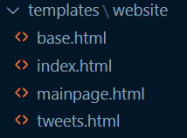
My Templates
Templates are the design of my websites that work hand in hand with my views. They also work with static files in my website which contain the styling of my html files.

Slide 14
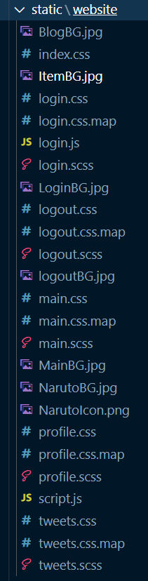
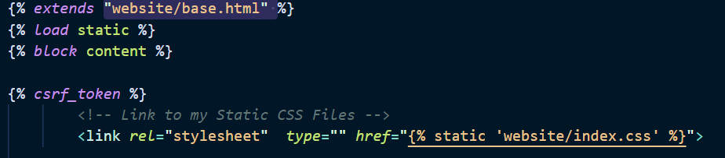
Static Files
My static files contain pictures, css, and javascript files that help my website be designed the way I want it to. They are called static files because they are not used for any dynamic programming purposes in terms of Django. (Javascript is a programming language however Django cannot utilize it in anyway so it is viewed as a static file)
Loading Static Files
Question: Why isn’t HTML a static file???

Slide 15
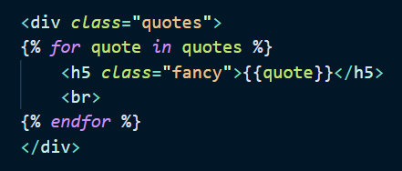
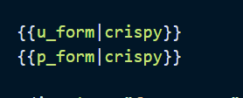
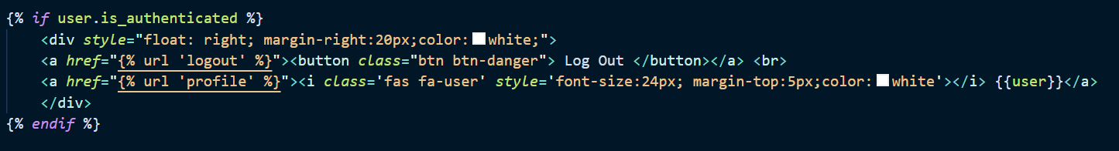
What is Jinja
Jinja is a modern and designer-friendly templating language for Python, modelled after Django’s templates. It is fast, widely used and secure with the optional sandboxed template execution environment. Jinja is basically an engine used to generate HTML or XML returned to the user via an HTTP response. - https://docs.appseed.us/what-is/jinja/
I use Jinja with my templates which allows conditionals, loops, passing variables, and more within my html files. That is why it is not a static file
Ex)

Slide 16
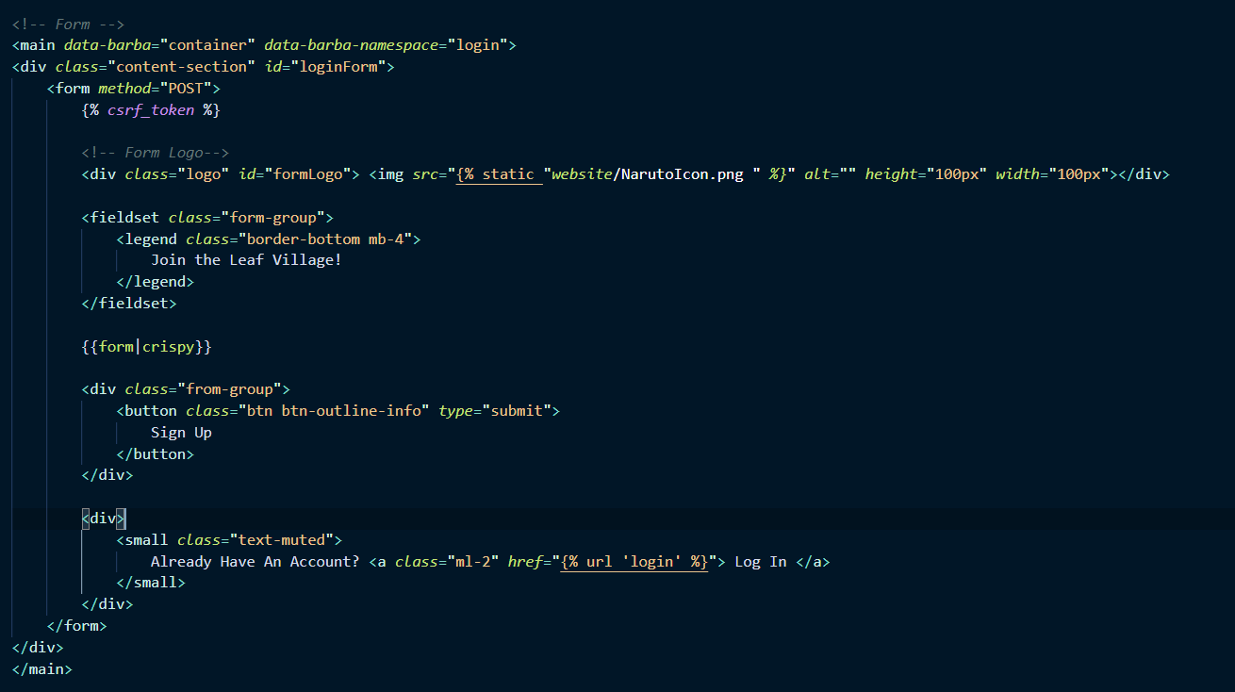
REGISTER.HTML
To add our form inside our website we Make the necessary html and with the power of Jinja and our view that gave our template the form we made previously, we just use the following syntax : {{ form|crispy }}. Crispy is a third party resource made for django used to style forms in a bootstrap manner. We will discuss it later.

Slide 17
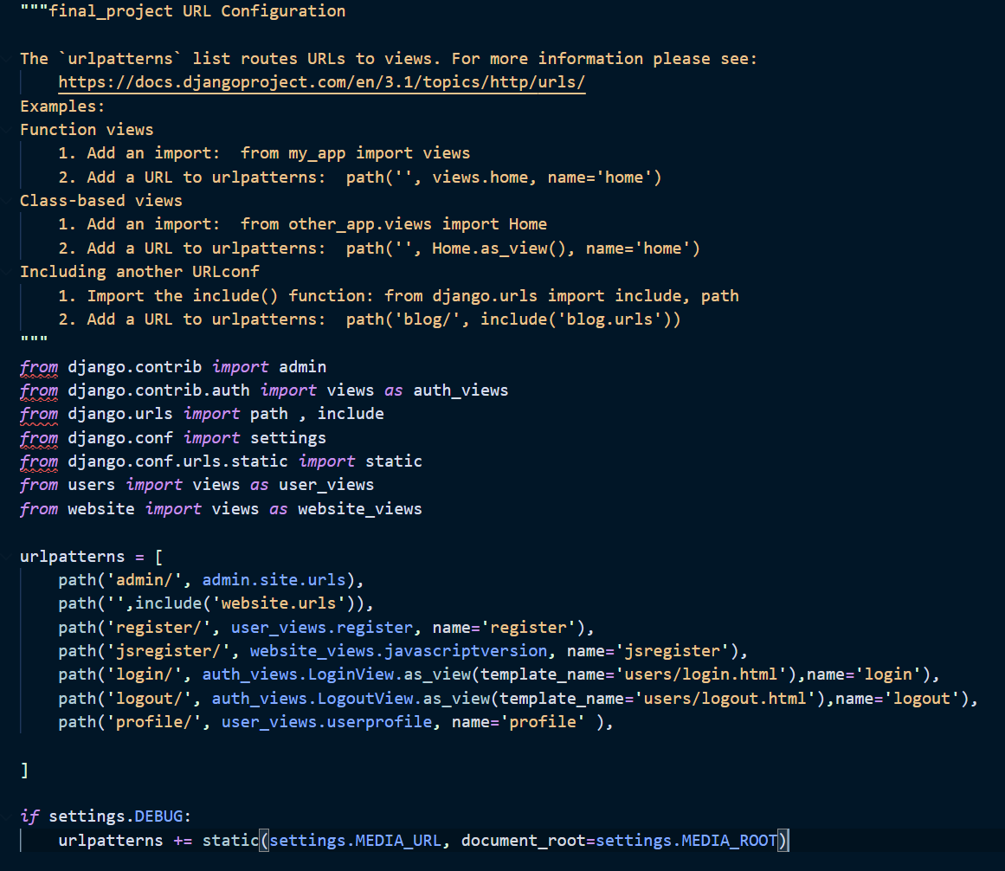
URLS
In my urls file I import all the necessary modules especially my views that I need. The url file is supposed to be a list of paths that routes the user in your webpage.
-website.com/admin
website.com/
website.com/register/
website.com/jsregister/
website.com/login/
All we have to do is specify a route, a view, and an alias name

Slide 18
DATABASES
The database engine Django uses by default is SQLite and can be accessed by the python shell. (python manage.py shell)
The makemigrations command will make the tables in your database based off your models.
You can input data into your tables manually within the shell or you can do it within your views via a function
The .save() method adds the object into your database

Slide 19
DATABASES
You can run queries on the shell to see your tables.
To have it be saved via a function you have to use a combination of model, view, and forms
The three step guide to making changes to your tables is this:
Change your models (in models.py).
Run python manage.py makemigrations to create migrations for those changes
Run python manage.py migrate to apply those changes to the database.

Slide 20
CRISPY FORMS
Crispy Forms is a popular third party django application that will help us style our forms. To set up crispy forms you have to pip install django-crispy-forms
Then within your settings.py you have to add in ‘crispy_forms’ in your INSTALLED_APPS list
Then inside of your template you can put in a code block using Jinja usually done at the top of your template. {% load crispy_forms_tags %}
Then when you want a form to be styled with crispy the following syntax can be used
{{ form|crispy }}

Slide 21
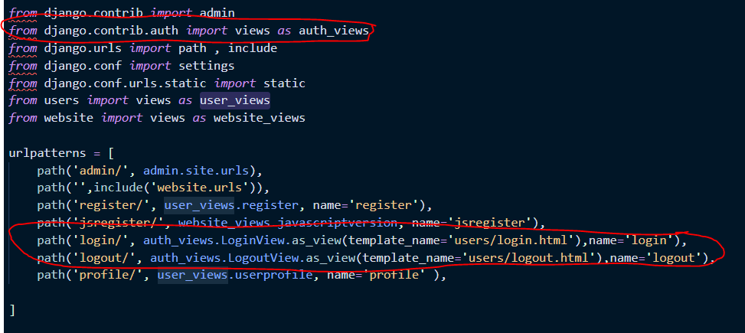
LOGIN LOGOUT VIEWS
Django provides for us views made for logging in and logging out purposes. This can be imported within urls.py and there is no need to do any coding within views.py unless overwriting is wanted.

Slide 22
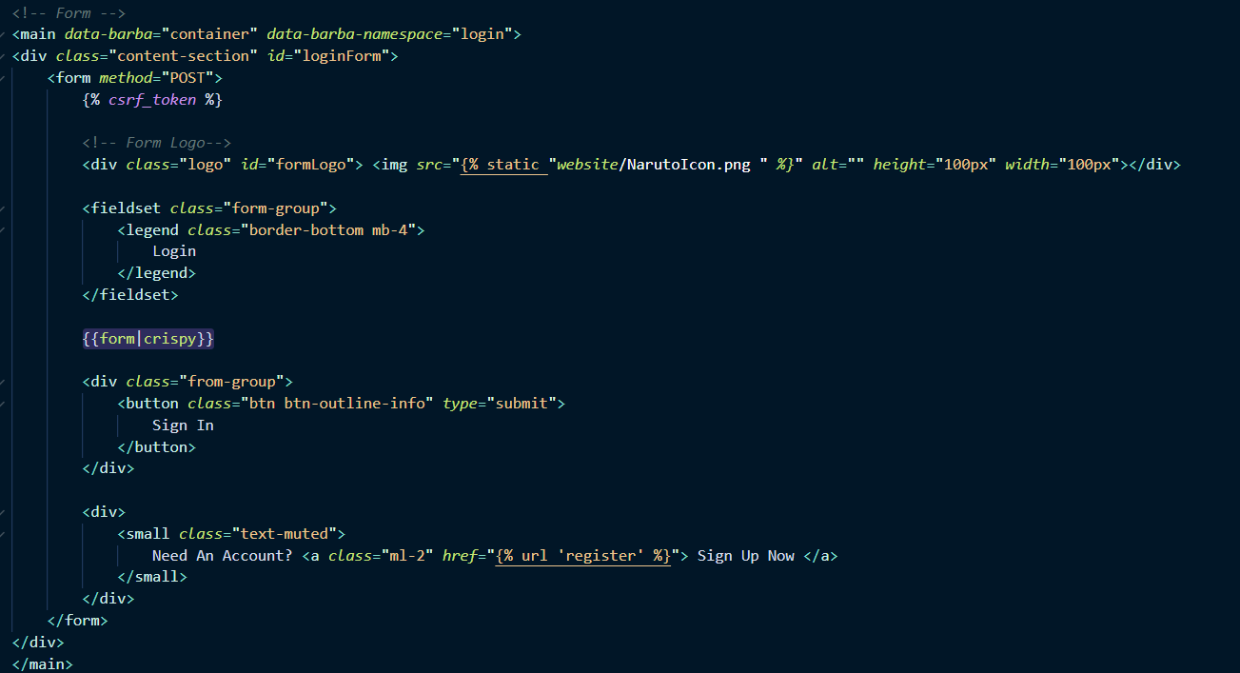
LOGIN TEMPLATE
The login template would be just an html file very similar to the registration template. The Login view given to us by Django handles the models and fields we just have to put the form within our template.

Slide 23

LOGIN REDIRECT
The settings.py file is in your base project folder of your Django project. Here you can specify when a user is logged in where to redirect the user to. In this case I made it the home screen.

Slide 24
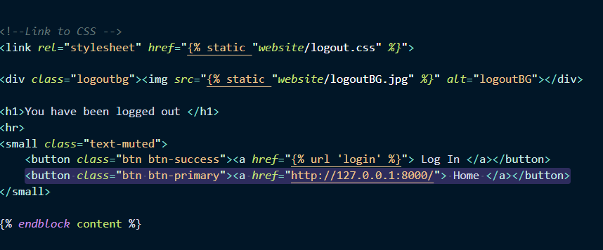
LOGOUT TEMPLATE
Very simple template because when someone is redirected to this URL the view automatically logs the user out. Then I just have some buttons to Redirect to the home page or login page in case the user wants to login again.

Slide 25
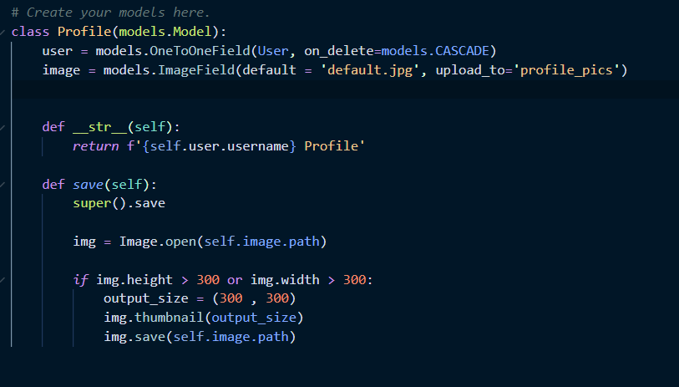
PROFILE MODEL
Since a profile usually has a profile pic that isn't a field within the user model. We need to add that field manually so we will make our own profile model.
User variable connects this model to the
User model that Django provides for us and the on_delete parameter means if the user is deleted then the profile is deleted as well in the database. However if a profile is deleted the user will not be deleted.
Image variable is making a field for the model where the user can upload a profile picture. Default parameter is specifying the default image when a profile is created and upload_to parameter is the directory pictures get uploaded to.

Slide 26
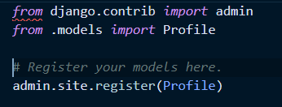
REGISTERING THE MODEL
Upon making migrations and saving them to the database it is also necessary to register them in your admins.py file in order for the model to pop up in your admin site. It is easy all you need to do is import the model in admins.py and do the following code:

Slide 27

IMAGE HANDLING
When working with an image field Django has a third party application used to handle them in the models. This will enable you to make migrations of images into your database. This third party app is Pillow. The Python Imaging Library, this adds image processing capabilities to your Python interpreter. Once this is installed by doing a pip install pillow in your terminal you can make the migrations.
Next let’s think about the directory for the images. For now it will make a directory called profile_pics and add every profile’s picture to that directory which is fine but maybe we want to add a directory just for media to avoid the congestion of files in our project directory. So in the settings.py we will add the following.

Slide 28
IMAGE ROOTS
The media root variable will make a directory of media which the profile pics directory will be made into. This will organize our file system a lot better and we used to os.path method to ensure cross platform compatibility on different operating systems for our project. The join method will join our project directory which is our BASE_DIR variable that Django makes upon initializing a Django project, with a string of ‘media’. This will just simply make a directory called media in our base directory.
The media url is the public route that people can view their profile pics in. So for example the url would be http://website/media/profile_pics/imgname

Slide 29
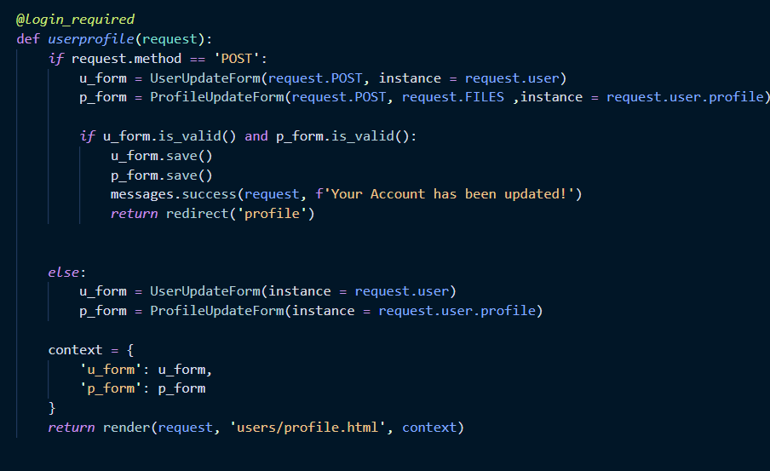
PROFILE VIEW
Okay so our user is created and he can login, logout, and register new accounts. Now we want to make our user able to view his profile. So now we want to make a profile view to begin this process. The logic will be explained later

Slide 30
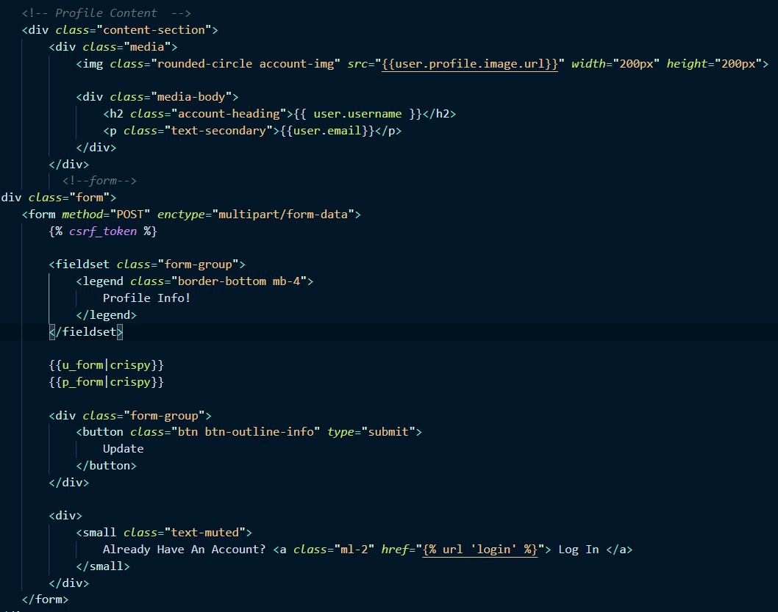
PROFILE TEMPLATE
The profile template is html file that will be displayed on our website. We will just discuss the Profile Content at the moment.
Using Jinja I can access the user model and its properties without the view feeding the template a context variable. So I can do the following syntax {{user.profile.image.url}} to get the url of the image within our file system. {{user.username}} and {{user.email}} is also valid and is used without any context given.

Slide 31
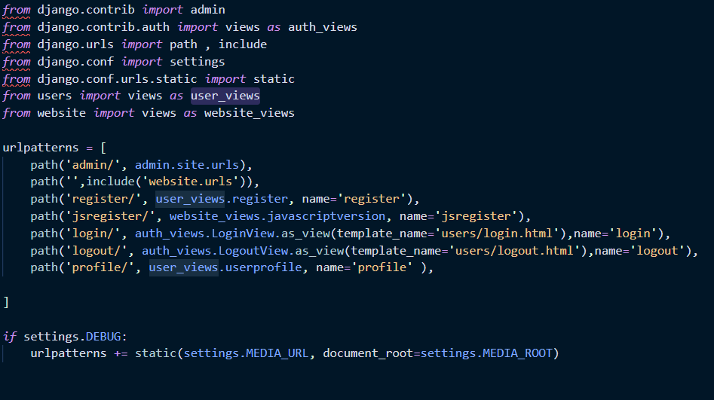
PROFILE AND MEDIA URLS
The final step is to add your template to your urls.py. The last element on our urlpatterns list is the path for our profile route. That’s taken care of and is easy.
However for our media to be shown on our website is going to be more complex. We have to do the follow imports:
From django.conf.urls.static import static From django.conf import settings
Our conditional says if we are in debug mode we will append the following static path to our urlpatterns list. This will take our media url which is just a route and the document root is the image directory where we will look for the image.

Slide 32

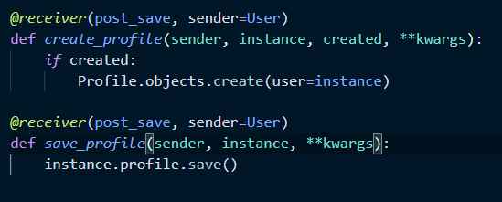
DJANGO SIGNALS
Okay so now we want to make it so when a User is created then a Profile is also created. The way we do that is with django signals.
A signal is something that fires when an object is created. So in essence we need to fire a signal when a user is created and this signal will make it so a function is called to create a Profile and save it to the database.
So a function acts as a receiver so that once it receives a signal it will be invoked. We make a function a receiver with a decorator of @receiver. The parameters the receiver decorator takes is a post_save signal and a sender variable. User will send a post_save signal to this function, thus why it is set equal to a sender.

Slide 33
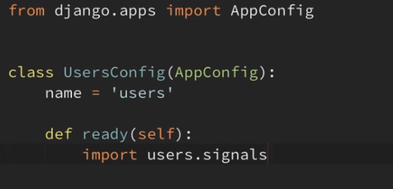
DJANGO SIGNALS PT2
The decorator also gives our functions the parameters it needs such as instance will be equal to the User object. Created will be a boolean value if a User object is created. **kwargs will be any additional values added to the functions parameters.
The save profile method is very identical to the create profile method. This just saves the profile to the database.
Lastly you have to import your signals into your apps.py file in this manner. This the Django convention.

Slide 34
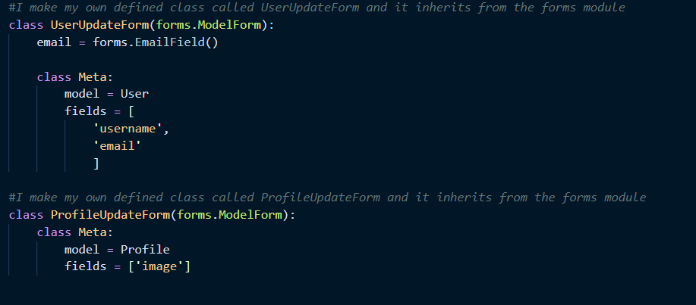
UPDATE FORMS
Now we want to give the ability for the user to update his information . So lets make forms for our User model and our Profile model in forms.py.

Slide 35
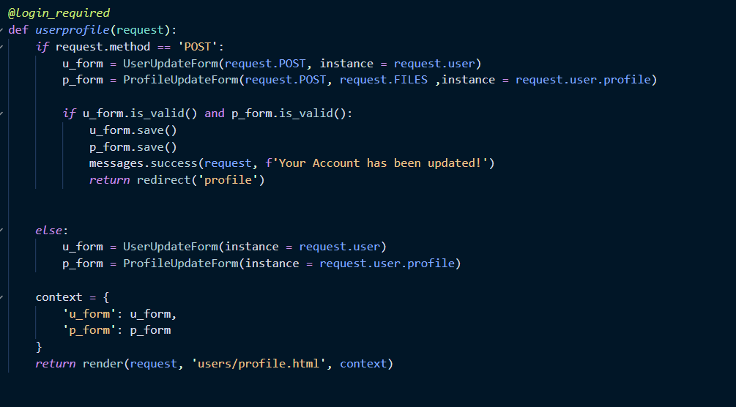
UPDATE FORMS PT 2
Now inside our views.py we make a function with a login_required decorator. The conditional will be true if there is a post request being invoked or else it just makes an instance of our UpdateForms we made previously. It then puts it in a context variable and then feeds it to the profile.html template.

Slide 36
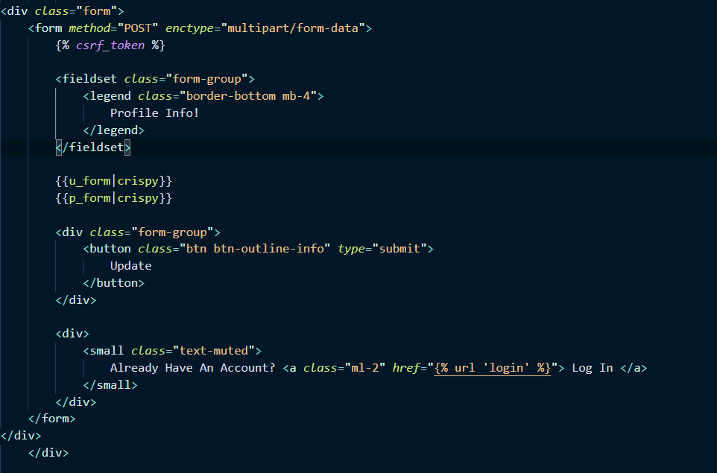
UPDATE FORMS PT3
Lastly we have to put these forms into our website so we need to put these forms in our template. We are going to insert these forms into our profile.html.
As you can see we put our user form and our profile form into our profile.html :
{{ u_form|crispy }} and {{ p_form|crispy }}
And they are both inside of a form html tag so it appears these two forms are one form from the website’s perspective. This is good since we will update our user and our profile model in the click of one submit button.

Slide 37
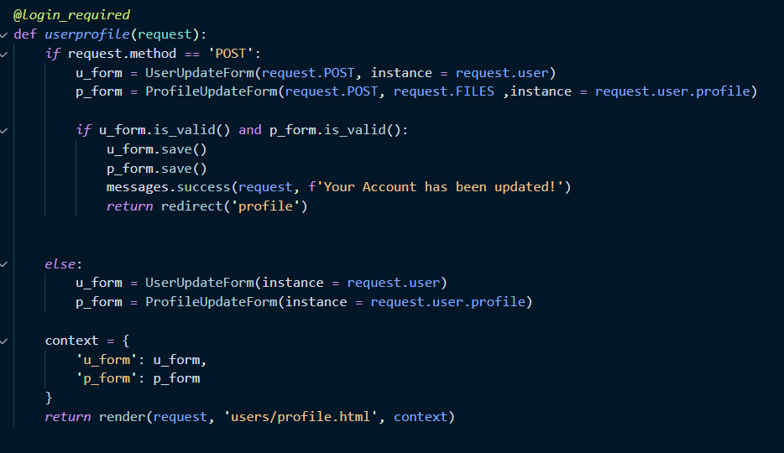
UPDATE FORMS PT 5
The conditional in our views will run if there is a post request and the logic in the conditional just creates the forms with the post request data given form the form. Then we have another conditional that checks if the forms are validated and then saves it to the database and makes a flash alert

Slide 38
Tweepy API
Tweepy is an API by twitter that helps developers extract data and information from Twitters platform. It is done by making a developer account and authorizing an Application.
The necessities of making a tweepy app is getting the tokens and keys first to authenticate
ACCESS TOKEN, ACCESS TOKEN SECRET
CONSUMER KEY, CONSUMER KEY SECRET

Slide 39
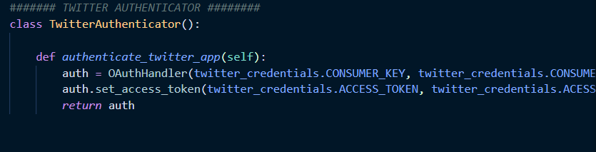
Authenticator
First I imported OAuthHandler from tweepy and then made a class named Twitter Authenticator
I made a function with the purpose of authenticating
I make a variable and set it to an OAuthHandler object with my consumer keys
Then I use a function from the OAuthHandler module named .set_access_token() and passed in my access tokens into the function
Lastly I return the auth object

Slide 40
TWEEPY
Tweepy is a python library used to access the twitter API. It is used for automation and creating twitter bots. Tweepy carries a bunch of other features as well.

Slide 41
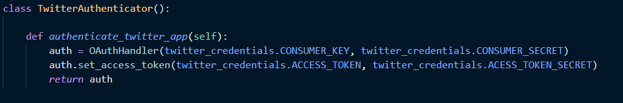
Authenticator
First step is making an Authenticator. An Authenticator will take my consumer keys and access tokens to give my app permission to utilize the Twitter API. This authorization is done by the OAuthHandler class in the tweepy module.

Slide 42
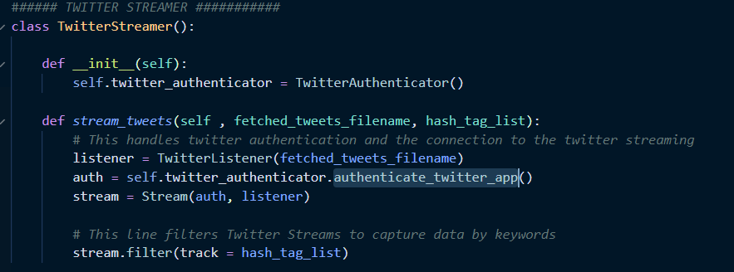
Streamer
I make a TwitterStreamer class and it has a class property of twitter_authenticator. I made it equal to a TwitterAuthenticator() object that takes care of authorizing my app.
Then I made a stream_tweets method that has two parameters one for the filename and one for a list of hashtag filters to specify specific tweets.
Within this method I make an OAuthHandler object called auth and I use a method called authenticate_twitter_app() which returns the value of an OAuthHandler object.
I then make a stream object variable from the tweepy module and give it the parameters of auth and listener.
Then I filtered the stream based off of the hash_tag_list by using the filter() method and passing the track variable set equal to the hash_tag_list.

Slide 43
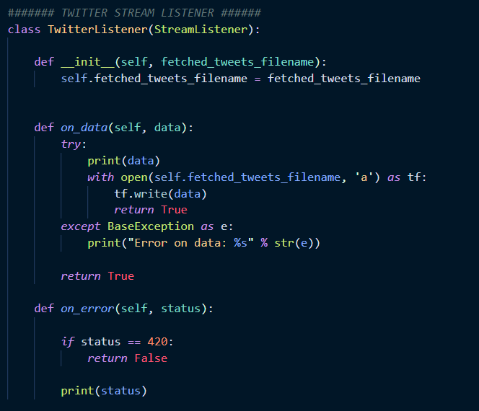
Stream Listener
I make a class named TwitterListener that inherits from the StreamListener class which is from the streaming module. I make a constructor that establishes a class property called fetched_tweets_filename. This, as the name implies, will take the value of the fetched tweets.
Then I make a function called on_data() that has a parameter of data. Then it continues with a try and except statement that opens a file and appends to it the data we have from the functions parameter.
This parameter ‘data’ will all be defined in other functions.
After on_data() we have an error handling function called on_error().

Slide 44
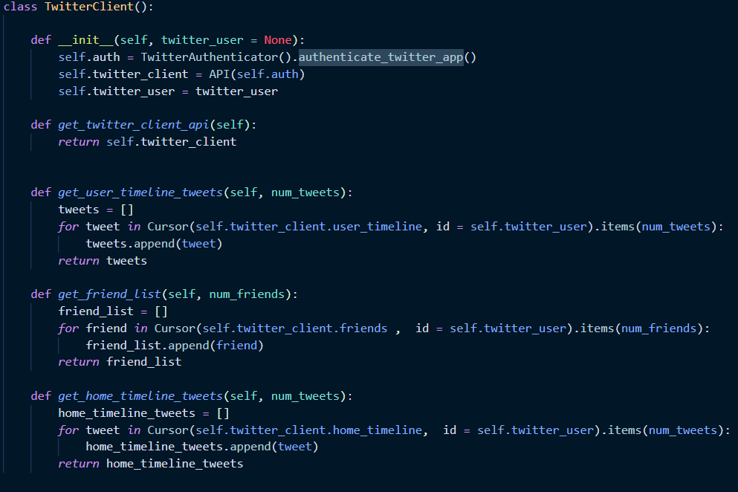
Client
I make class called TwitterClient() that makes use of the API class from the tweepy module and also the Cursor class to define our twitter user.
The cursor object lets us do pagination so we don't show every single tweet of a user in one page. The API object lets us get the timeline, friends, and other valuable functions for the user
In our constructor we authenticate our app , we make a twitter client variable with the API object that takes an authenticated app as it’s parameter. Then we make a twitter_user variable that will have the default value of none unless specified and be what we pass into our constructor.
Then we have functions that get the user’s timeline tweets, friends list, and home timeline tweets.

Slide 45
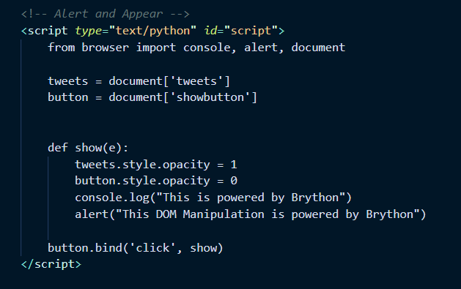
Brython
I wanted to do some DOM Manipulation for my website and needed to find a way to make it be done with Python. Thankfully, Brython is the answer to that.
Brython is a Python Implementation for client-side web programming. With the help of Javascript you can run Python on the client side of your website and have it do DOM manipulation and more.
This is done by running a
Script inside your html and
Just writing python within your
script.

Slide 46
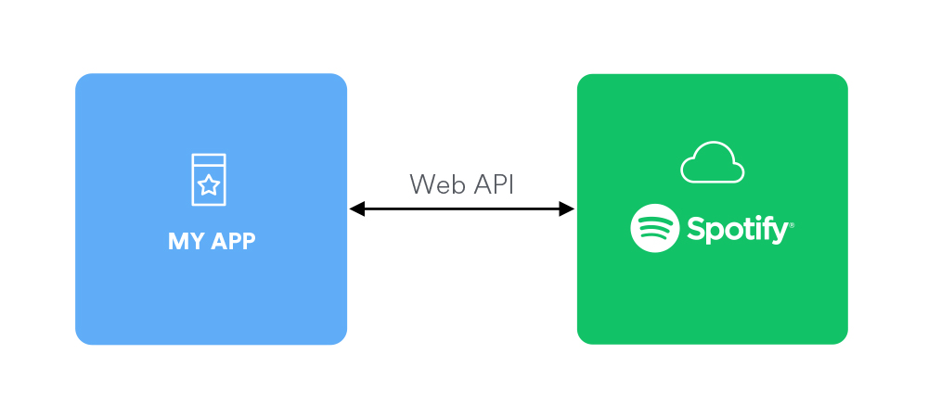
SPOTIPY
Spotipy is a lightweight Python library for the spotify web api.

Slide 47
Authentication
In my code similar to the tweepy library, I had to do an authenticator to allow my app to have permission to use the spotify web API.
In spotipy the way authentication is easy and it is just one line of code.
We have to use the spotipy library and use the Spotify object. Upon instantiation we pass in an arguement of a SpotifyClientCredentials object that we imported from the spotipy library aswell. The SpotifyClientCredentials object takes in our client id and client secret tokens given to us from our spotify developer account when making our app.

Slide 48
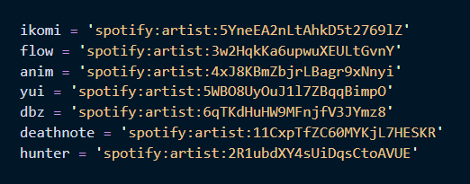
SPOTIFY URI
Every artist on spotify has an artist URI. I used this from every artist I wanted to play a song on my website from.

Slide 49
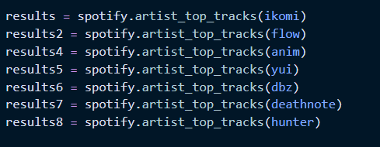
Artist’s Top Tracks
I then passed in these values to the artist_top_tracks() method which returns a dictionary of lists based on what I want. It can be song title, song preview, album image, length, etc.

Slide 50
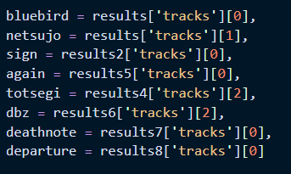
TRACKS
Here we target the top tracks and use the tracks key value as our index and get the desired track we want by the specific index value.

Slide 51
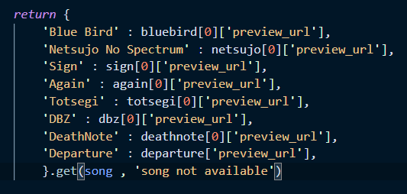
Return Specified Song Preview
To return the specified the specific song we use a python equivalent switch statement where we can get a specific return value based off a string we put into the method. The .get() method lets us do that when we have a dictionary we are working with. If there is not the song we are looking for it will return ‘song not available’

Slide 52
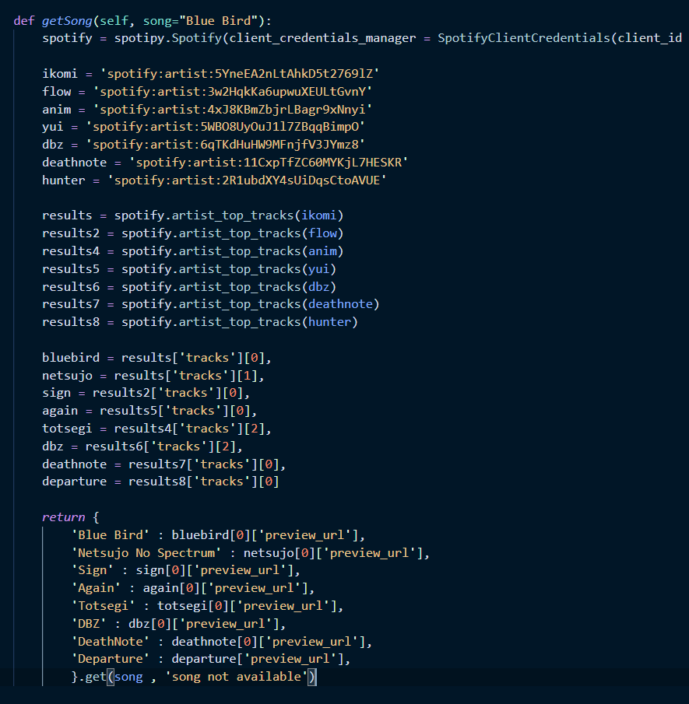
getSong() method

